Slide 1
GIT & GIT HUB

Slide 2
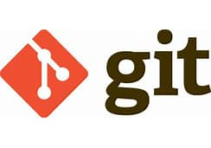
GIT
Git was created by Linus Torvalds in 2005 to develop Linux Kernel.
It is also used as an important distributed version-control tool for the DevOps
Git is a modern and widely used distributed version control system in the world.
It is developed to manage projects with high speed and efficiency.
The version control system allows us to monitor and work together with our team members at the same workspace.
It is designed to handle minor to major projects with high speed and efficiency.
It is developed to co-ordinate the work among the developers.
The version control allows us to track and work together with our team members at the same workspace.
Git is foundation of many services like GitHub and GitLab, but we can use Git without using any other Git services. Git can be used privately and publicly.
DOWNLOAD: https://git-scm.com/downloads

Slide 3
What is version control and how can you document changes?
Version control — also known as source control or revision control
It is software used to track revisions, solve integration conflicts in code, and manage different artifacts involved in software projects (e.g. design, data, images).
Version control also enables frictionless communication, change, and reproducibility between developers and other team members.
Version control is the foundation and the stepping stone of DevOps, software architecture, and release patterns, without which an org cannot start.
Using version control results in remarkable team productivity and software quality improvements.

Slide 4
Why should you use Git?
Git’s ability to store a complete history of a project locally is a benefit, because Git branches are lightweight and the protocol is fast, so contributors can be anywhere, even with a poor connection and still sync a local copy with any other team member.

Slide 5
Snapshots
The way git keeps track of your code history
Essential records what all your files look like at a given point in time
We can decide when to take snapshot and what files
Have the ability to go back to visit any snapshot

Slide 6
Commit
The act of creating a snapshot
Can be a noun or verb – I commited code
A project made up of a bunch of commits

Slide 7
Repositories
A collection of all the files and the history of those files
Can live on a local machine or on a remote server(Github)
The act of copying a repository from a remote server is called Cloning
The process of downloading commits that don’t exist on your machine from a remote repository is called pulling changes
The process of adding your local changes to the remote repository is called pushing

Slide 8
Branches
All commit in git live on some branch , But there can be many branches
The main branch in a project is called master branch

Slide 9

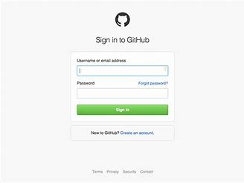
GitHub
Create an account in Github
https://github.com/login

Slide 10
What Is GitHub?
GitHub is an open-source repository hosting service, sort of like a cloud for code.
It hosts your source code projects in a variety of different programming languages and keeps track of the various changes made to every iteration.
Other GitHub users can review your code and propose changes.
A defining feature of GitHub is its robust version control system.
The version control lets coders tweak software—potentially fixing bugs or improving efficiency—without affecting the software itself or risking the experience of any current users.
Proposed changes can be easily merged into the live software after the proposals are reviewed and approved.

Slide 11
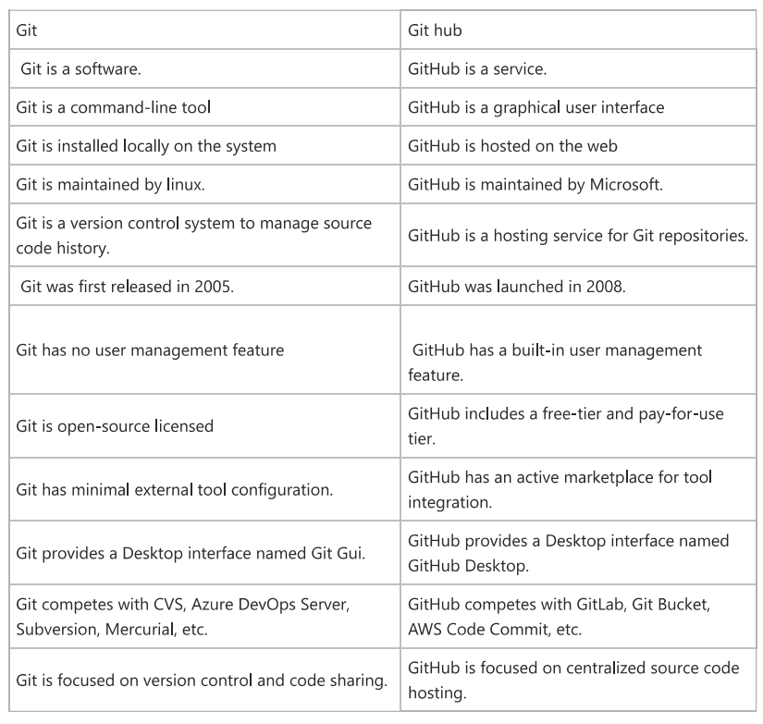

Slide 12
Steps to push the project file
->git status
->git init
->git status
->git add .
->git status
->git commit -m "message"
->git config --global user.email "you@example.com"
->git config --global user.name "Your Name“
->git commit -m "message"
------go_to_git_hub_page------create_a_repository-----copy_6th command-------------
->git remote add origin https://github.com/email/ns_portfolio.git
->git push origin master

